Slide 1

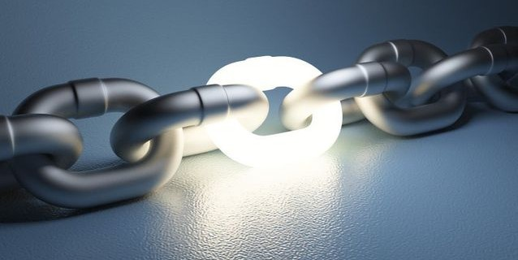
Course Summary -- A Blockchain-Powered Future
LING Zong, Ph. D.
Senior Software Engineer / Scientist
IBM Almaden Research Center
San Jose, California, U.S.A.
Notes:
Thanks, pleasure etc.
There is much hype around Blockchain.
Most of this relates to the use of Blockchain to underpin the Bitcoin crypto currency.
Whilst IBM are not interested in Crypto currency, we are very interested in exploring the broader business application of Blockchain technology. This is a transformational opportunity for many of our clients
This touches most all industries – we are making Blockchain REAL for business.

Slide 2
Lecture Outline
Course Objectives
A Day in Blockchain Utopia
Bitcoin Development
Smart Contracts
Community, Politics, & Regulation
The Fight for Privacy
Scaling Bitcoin
A Blockchain-Powered Future
Course Examination

Slide 3

Course Objectives (as instructor)
Help audience
Familiar with the fundamental concepts of BlockChain;
Competent in recognizing challenges faced by applications dealing with scalable solutions;
Understand how BlockChain impacts business intelligence, scientific discovery, and day-to-day life;
Illustrate the code development of BlockChain implementation on Hyperledger project.
Notes:
3

Slide 4

Course Benefits (as audience)
Broaden Horizon
Engage Experience
Expand Self-concerns
Improve Life Quality
Notes:
4

Slide 5
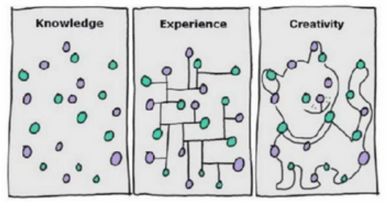
Course Contents
Knowledge
Experience
Methodology
Practice
Notes:
5

Slide 6
Course Plan
Unit1: Course Introduction, BlockChain for Business
Unit2: IT Infrastructures，IOT
Unit3: Bitcoin Basics，Bitcoin History
Unit4: Ethereum，Enterprise Blockchain
Unit5: BlockChain Foundation for Developers
Unit6: Blockchain Anonymization, Cryptography
Unit7: Bitcoin Scalability, ICO
Unit8: Zero-Knowledge Proof, The Libra, Course Summary
Notes:
6

Slide 7
A Day in Blockchain Utopia
Notes:
payments and sharing economy
You leave the apartment where you spent the night, and as you leave, sensors detect your departure and Slock.it’s smart contract pays back your security deposit. You order a coffee from Peet’s on your smartphone and as you pull up your payment, a notification pops up. It’s a reminder to extend your payment channel with the global lightning network. You’re a little fuzzy on the details because the last time you had to touch your payment channels was 10 years ago, but since it’s all secure and doesn’t cost you any money anyway you decide to extend your payment channel for another 20 years.
Autonomous cars
You call ‘your’ car, but it’s not really yours; it’s plugged into an autonomous ad hoc swarm of vehicles readily available for use. Accidents are rare, but when they do happen, the insurance agency analyzes video footage via a machine-learning trained bot and automatically gives the victim in the accident the appropriate payment. Except it’s not actually an insurance agency - it’s a smart contract that pools together the funds of a multitude of owners and charges people the exact expected value of car insurance, taking no profit. The near exact probability of accidents is known because every accident that has ever happened is recorded on the blockchain.
Work
You head off to your company headquarters to work for the day. Except your work isn’t really work - it’s all voluntary because the blockchain ensures a universal basic income for everyone, and you’re an engineer and researcher by trade primarily because you want to help push the boundaries of human knowledge. Your company isn’t really a company either - it’s a decentralized autonomous organization consisting of individuals from around the world who voluntarily signed up, receive compensation and pay raises based off the quantity ad quality of their research findings as determined by a worldwide oracle network, and who can exit their contract at any time. Your company itself receives revenue over time as measured by the net benefit to society your research brings.
Government
For the few functions of society left that still require a government, it’s run by a democratic futarchy where the markets decide which policies should be implemented, completely removing the possibility of corrupt politicians who know little to nothing about the fields they write legislation for.

Slide 8
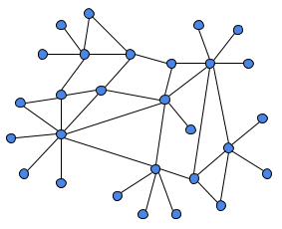


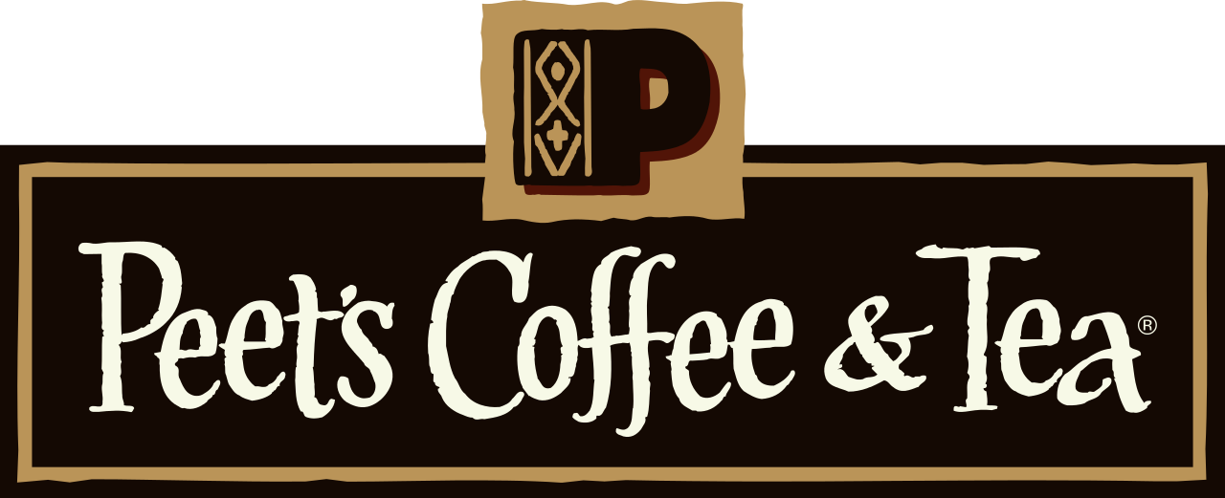




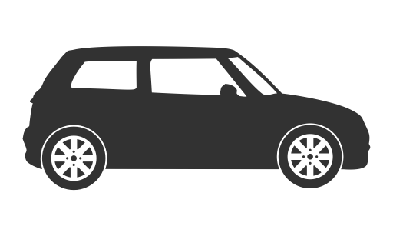
The Utopian blockchain world
Notes:
You leave the apartment where you spent the night, and as you leave, sensors detect your departure and Slock.it’s smart contract pays back your security deposit. You order a coffee from Peet’s on your smartphone and as you pull up your payment, a notification pops up. It’s a reminder to extend your payment channel with the global lightning network. You’re a little fuzzy on the details because the last time you had to touch your payment channels was 10 years ago, but since it’s all secure and doesn’t cost you any money anyway you decide to extend your payment channel for another 20 years.

Slide 9


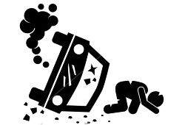
The Utopian blockchain world
Insurance smart contract
Notes:
You call ‘your’ car, but it’s not really yours; it’s plugged into an autonomous ad hoc swarm of vehicles readily available for use. Accidents are rare, but when they do happen, the insurance agency analyzes video footage via a machine-learning trained bot and automatically gives the victim in the accident the appropriate payment. Except it’s not actually an insurance agency - it’s a smart contract that pools together the funds of a multitude of owners and charges people the exact expected value of car insurance, taking no profit. The near exact probability of accidents is known because every accident that has ever happened is recorded on the blockchain.

Slide 10
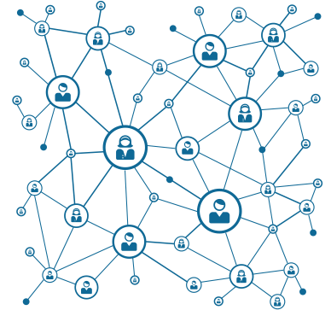


The Utopian blockchain world
DAO
Notes:
You head off to your company headquarters to work for the day. Except your work isn’t really work - it’s all voluntary because the blockchain ensures a universal basic income for everyone, and you’re an engineer and researcher by trade primarily because you want to help push the boundaries of human knowledge. Your company isn’t really a company either - it’s a decentralized autonomous organization consisting of individuals from around the world who voluntarily signed up, receive compensation and pay raises based off the quantity ad quality of their research findings as determined by a worldwide oracle network, and who can exit their contract at any time. Your company itself receives revenue over time as measured by the net benefit to society your research brings.

Slide 11
The Utopian blockchain world
Futarchy is a form of government proposed by economist Robin Hanson, in which elected officials define measures of national wellbeing, and prediction markets are used to determine which policies will have the most positive effect.
vote on values, bet on beliefs
https://en.wikipedia.org/wiki/Futarchy
Notes:
For the few functions of society left that still require a government, it’s run by a democratic futarchy where the markets decide which policies should be implemented, completely removing the possibility of corrupt politicians who know little to nothing about the fields they write legislation for.
Futarchy是一种管理的模式，它将预测市场放到了决策的核心。其基于的是以下的基本假设： 民主管理制度因为没有聚合可用的信息，而惨遭失败； 投机市场是聚合可用信息的最佳已知方法； 当创作者Robin Hanson首次描述Futarchy时，他指的Futarchy是作为一种单一民族国家的管理方式，但是这个术语已普遍在预测市场当中应用（特别是在加密管理领域）。这个领域当中的大多数人，已熟悉了这种设计以及预测市场（Augur, GroupGnosis）的功能。如果没有，预测市场其实与简单的投机市场类似，在这些市场中，人们可以对未来的状况进行下注，并根据准确性进行奖励或者惩罚。 http://www.8btc.com/dao-2-0

Slide 12
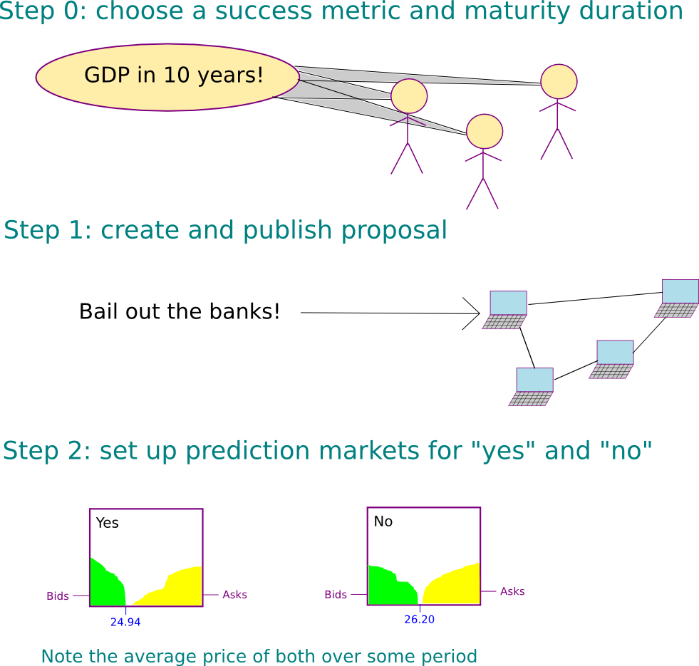
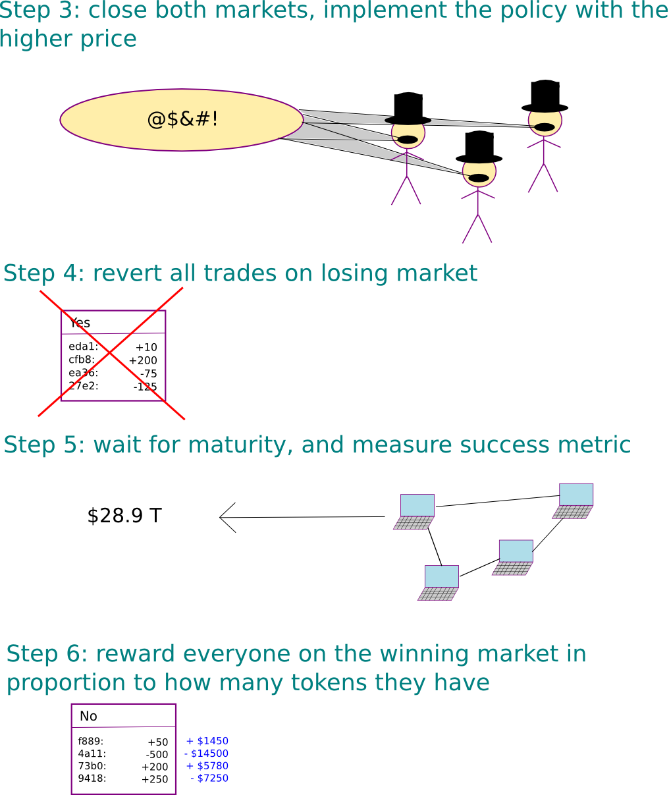
The Utopian blockchain world
Notes:
https://ethfans.org/posts/introduction-futarchy-part-1
For the few functions of society left that still require a government, it’s run by a democratic futarchy where the markets decide which policies should be implemented, completely removing the possibility of corrupt politicians who know little to nothing about the fields they write legislation for.
Futarchy是一种管理的模式，它将预测市场放到了决策的核心。其基于的是以下的基本假设： 民主管理制度因为没有聚合可用的信息，而惨遭失败； 投机市场是聚合可用信息的最佳已知方法； 当创作者Robin Hanson首次描述Futarchy时，他指的Futarchy是作为一种单一民族国家的管理方式，但是这个术语已普遍在预测市场当中应用（特别是在加密管理领域）。这个领域当中的大多数人，已熟悉了这种设计以及预测市场（Augur, GroupGnosis）的功能。如果没有，预测市场其实与简单的投机市场类似，在这些市场中，人们可以对未来的状况进行下注，并根据准确性进行奖励或者惩罚。 http://www.8btc.com/dao-2-0

Slide 13


The Utopian blockchain world
democracy would continue to say what we want, but betting markets would now say how to get it
Notes:
https://ethfans.org/posts/introduction-futarchy-part-1
For the few functions of society left that still require a government, it’s run by a democratic futarchy where the markets decide which policies should be implemented, completely removing the possibility of corrupt politicians who know little to nothing about the fields they write legislation for.
Futarchy是一种管理的模式，它将预测市场放到了决策的核心。其基于的是以下的基本假设： 民主管理制度因为没有聚合可用的信息，而惨遭失败； 投机市场是聚合可用信息的最佳已知方法； 当创作者Robin Hanson首次描述Futarchy时，他指的Futarchy是作为一种单一民族国家的管理方式，但是这个术语已普遍在预测市场当中应用（特别是在加密管理领域）。这个领域当中的大多数人，已熟悉了这种设计以及预测市场（Augur, GroupGnosis）的功能。如果没有，预测市场其实与简单的投机市场类似，在这些市场中，人们可以对未来的状况进行下注，并根据准确性进行奖励或者惩罚。 http://www.8btc.com/dao-2-0

Slide 14
Bitcoin Development
Notes:
payments and sharing economy
You leave the apartment where you spent the night, and as you leave, sensors detect your departure and Slock.it’s smart contract pays back your security deposit. You order a coffee from Peet’s on your smartphone and as you pull up your payment, a notification pops up. It’s a reminder to extend your payment channel with the global lightning network. You’re a little fuzzy on the details because the last time you had to touch your payment channels was 10 years ago, but since it’s all secure and doesn’t cost you any money anyway you decide to extend your payment channel for another 20 years.
Autonomous cars
You call ‘your’ car, but it’s not really yours; it’s plugged into an autonomous ad hoc swarm of vehicles readily available for use. Accidents are rare, but when they do happen, the insurance agency analyzes video footage via a machine-learning trained bot and automatically gives the victim in the accident the appropriate payment. Except it’s not actually an insurance agency - it’s a smart contract that pools together the funds of a multitude of owners and charges people the exact expected value of car insurance, taking no profit. The near exact probability of accidents is known because every accident that has ever happened is recorded on the blockchain.
Work
You head off to your company headquarters to work for the day. Except your work isn’t really work - it’s all voluntary because the blockchain ensures a universal basic income for everyone, and you’re an engineer and researcher by trade primarily because you want to help push the boundaries of human knowledge. Your company isn’t really a company either - it’s a decentralized autonomous organization consisting of individuals from around the world who voluntarily signed up, receive compensation and pay raises based off the quantity ad quality of their research findings as determined by a worldwide oracle network, and who can exit their contract at any time. Your company itself receives revenue over time as measured by the net benefit to society your research brings.
Government
For the few functions of society left that still require a government, it’s run by a democratic futarchy where the markets decide which policies should be implemented, completely removing the possibility of corrupt politicians who know little to nothing about the fields they write legislation for.

Slide 15
v4
Alice double spends with her multiple identities
A
A
A
B
C
A
A
Notes:
By setting up a large number of separate Identities on the bitcoin network, Alice can double spend on Bob and Charlie.
We want to make it costly for Alice to double spend, but it’s difficult to identify dishonest actors before they act, so we will simply make it costly for anyone to verify transactions.
In the bitcoin system that cost is called proof-of-work.

Slide 16
Simple Hash Commitment Scheme - Cheating
How could Bob cheat Alice?
When Bob receives C = H(B || R), if he can compute H⁻¹(C) = B || R, Bob can recover Alice’s guess and send her the opposite outcome!
If our hash function, H, is preimage resistant, this shouldn’t be possible.
How could Alice cheat Bob?
Alice sends Bob her commitment C = H(B || R), but reveals the opposite guess, (!B, R’). Alice wins if she can pick R’ s.t. C’ = H(!B || R’) = C.
This fails if our hash function, H, is second preimage resistant!

Slide 17
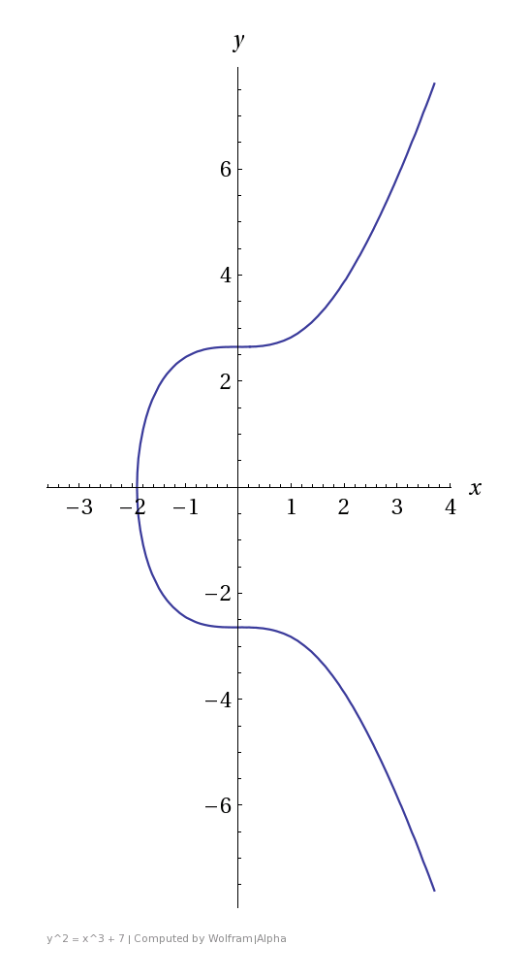
Elliptic Curves
secp256k1 : Y² = X³ +7
Bitcoin’s Elliptic Curve
An elliptic curve is defined by the following affine, long Weierstrass form:
We usually consider the short Weierstrass form:
For the most part, all you need to know about elliptic curves is that they provide another finite abelian group with certain desired properties.
ECDSA
ECDSA signatures are used in Bitcoin to show proof of ownership of the outputs of a transaction!

Slide 18
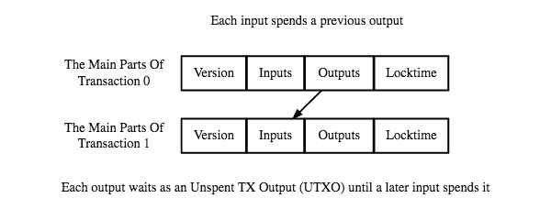
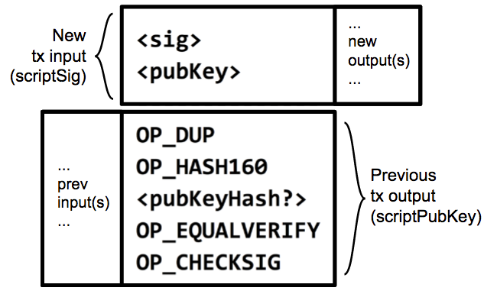
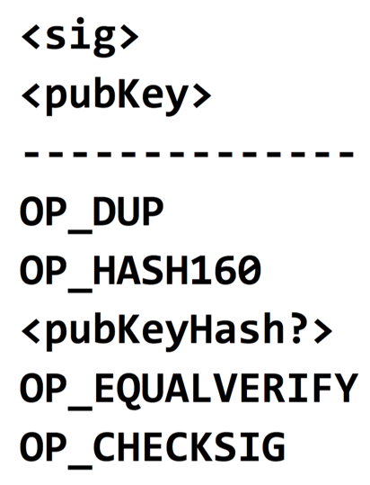
Bitcoin Scripting
PubKey
SHA-256
PubKeyHash
Remember: Hash(PubKey) == Address == "PubKeyHash"
Figure:
Two transactions along with their input and output scripts
...
new output(s)
...
New
tx input
(scriptSig)
Code Execution
1 <sig>
2 <pubKey>
3 OP_DUP
4 OP_HASH160
...
...
prev
input(s)
...
Previous
tx output (scriptPubKey)
Notes:
- To make the input script work with the output script, you simply concatenate them, with the input script coming first.
- This is really hacky, I know, but apparently this is how we like to do everything in Bitcoin.
- The formal terms for these is that our input script is called a scriptSig, and our output script is called our scriptPubKey
- This is because our output script specifies a public key, and our input script specifies a signature for that public key.
- Putting a scriptSig and a scriptPubKey together results in a working script that Bitcoin clients can run to verify that a redeeming transaction is valid.
- Let's take a closer look at how the script actually executes.

Slide 19
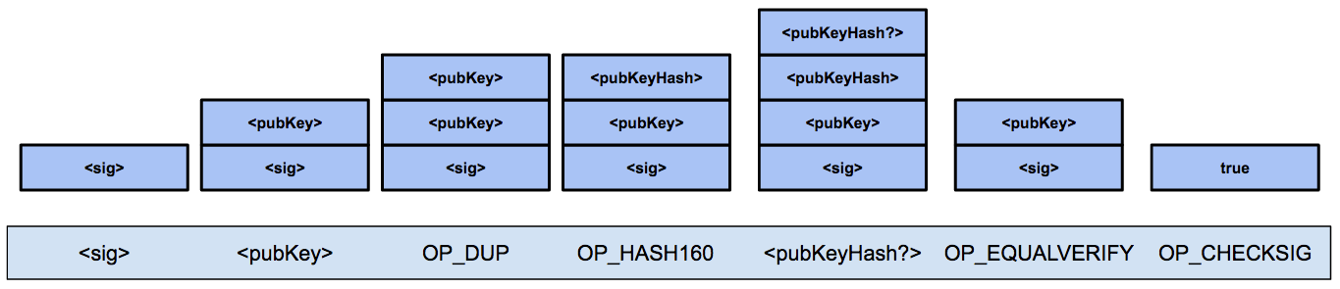
Bitcoin Scripting
Output says: "This amount can be redeemed by
1) the <pubKey> that hashes to address <pubKeyHash?>
2) plus a <sig> from the owner of that <pubKey>
...that will make this script evaluate to true."
Language built specifically for Bitcoin called "Script" or simply "the Bitcoin scripting language"
Stack based
Native support for cryptography
Simple
<pubKeyHash?>
<pubKey>
<pubKeyHash>
<pubKeyHash>
<pubKey>
<pubKey>
<pubKey>
<pubKey>
<pubKey>
<sig>
<sig>
<sig>
<sig>
<sig>
<sig>
true
<sig>
<pubKey>
OP_DUP
OP_HASH160
<pubKeyHash?>
OP_EQUALVERIFY
OP_CHECKSIG
Notes:
Bitcoin uses a language built specifically for Bitcoin called "Script" or "the Bitcoin scripting language."
- It's stack based, has built in instructions for cryptography like hashing and verifying signatures. It also has some reserved opcodes that will allow for the future extensibility of Bitcoin.
- It is very simple. Notably, it's not Turing-complete, which basically means that is very restricted in the logic that it can write.
- There's also no loops, which makes things easier since we don't have to worry about people writing infinite loops and stalling clients trying to verify transactions.
Walking through this example transaction:
- These first two instructions are from the input script (scriptSig) and specify the signature and public key. They're simply data instructions, so all you do is push these values onto the stack
- OP_DUP simply duplicates the topmost item on the stack
- OP_HASH160 hashes the topmost item on the stack. Remember that this pubKeyHash came from the input of the redeeming transaction, so it was specified by the recipient.
- This new <pubKeyHash?> came from the output script, so it was specified by the sender of the coins. In other words, in order to redeem this output, the receiver must provide the signature corresponding with the <pubKeyhash?> provided by the sender of the coins.
- Now, at the top of the stack we have <pubKeyHash?>, the address as specified by the sender, and <pubKeyHash>, the address that the recipient supplied in order to redeem these coins.
- We run an OP_EQUALVERIFY to check if the top two values at the stack match. If they don't match, it throws an error, otherwise the script continues execution.
- Lastly, OP_CHECKSIG checks the top two values on the stack and determines if they are a valid pubKey and signature. It replaces these values with true if so.
- Therefore, this script returns true and this new transaction has a valid redeeming script.

Slide 20
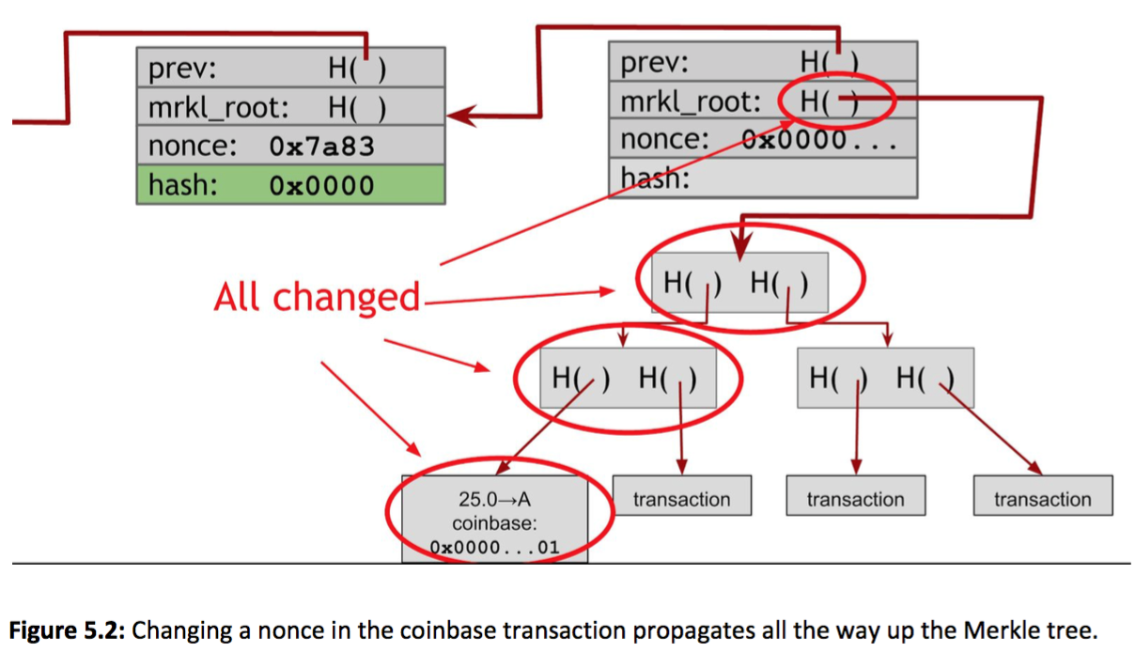

Merkle Tree - Bitcoin construction
What if there is no solution?
Block header nonce is 32 bits
Antminer S9 hashes 14 TH/s
How long does it take to try all combinations?
2^32 / 14,000,000,000,000 = 0.00031 seconds
Exhausted 3260 times per second
Therefore, must change Merkle root
Increment coinbase nonce, then run through block header nonce again
Incrementing coinbase nonce less efficient because it must propagate up the tree
Princeton Textbook
Notes:
We need two nonces because the block header nonce is 32 bits.
(go over points)

Slide 21
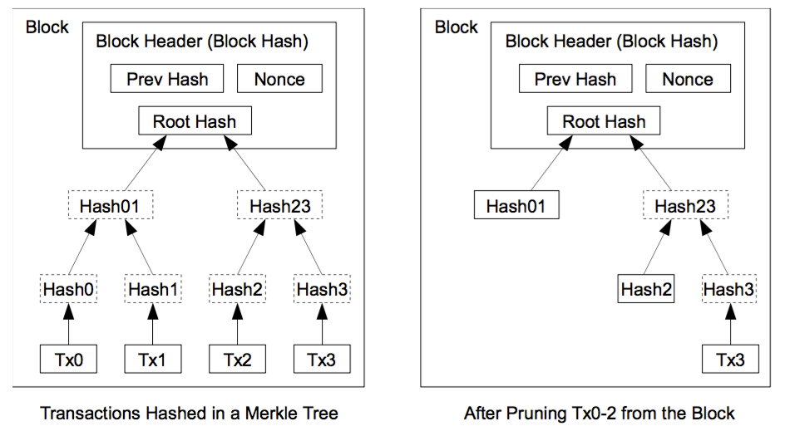
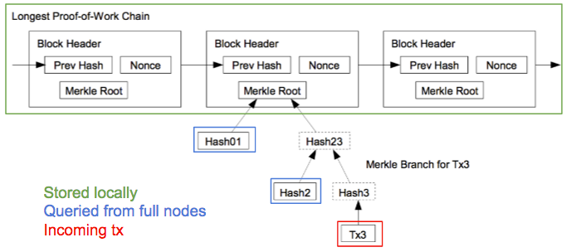
SPV - Security Analysis
SPV nodes:
Don't have full tx history, don't know UTXO set
Don't have same level of security of full nodes
Can't check if every tx included in a block is actually valid
SPV nodes assume:
...that incoming block headers aren't a false chain
Very expensive for attacks (or anyone) to create blocks
Not sustainable over the long term
...that there ARE full nodes out there validating all transactions
There are efficiency benefits and incentives to doing so
...that miners ensure that the transactions they include in their blocks are valid
Otherwise their blocks would be rejected by full nodes (very expensive mistake!)
Nakamoto, 2009
Notes:
Let's think about the security a little bit more.
SPV, Simplified Payment Verification
SPV nodes:
- SPV nodes don't have the full transaction history and doesn't know the set of unspent transaction outputs.
- Therefore, SPV nodes don't have the same level of security of full nodes, since it can't check to see whether every transaction included in a block is actually valid.
- They can only verify transactions that actually affect them, and must do so lazily.
Assumptions
- SPV nodes simply assume that the block headers that they're getting from the full nodes aren't a false block chain
- This is fair because it's really expensive for an attacker to mine these blocks, and the attacker wouldn't be able to sustain this over the long run unless they had over 51% of the mining power
- SPV nodes simply assume that there ARE full nodes out there that are validating all the transactions. There are efficiency benefits and incentives to doing so.
- They assume that the miners creating blocks are ensuring that the transactions they include in their block is valid.
- If the miners didn't check that the included transactions were valid, these blocks would be rejected by the full nodes validating blocks, and thus be a big waste of computational power.

Slide 22

Block Reward :: Difficulty Adjustment
Invalid Block
Equally likely to hit ring 1, 2, 3, …
Faster miners = more hits / second
Target: inside the yellow ring
Keep decreasing the size of the yellow ring…
Mining difficulty adjustment every 2016 blocks
Difficulty adjusted to
next_difficulty = previous_difficulty * (2 weeks) / (time to mine last 2016 blocks)
Valid Block
H(nonce || prev_hash || tx || tx || ... || tx) < target

Slide 23
FPGA Mining
 | hashes / second | time to block
CPU | 20 million | 300,000 years
GPU | 200 million | 30,000 years
FPGA | 1 billion | 600 years
ASIC | 10 trillion | 22 days
Field Programmable Gate Arrays
Getting more application specific
A trade-off between ASIC and general purpose

Slide 24





ASIC-Resistance: Scrypt
Scrypt is a hash function. The mining puzzle is the same partial hash-preimage puzzle.
Design considerations:
Used for hashing passwords
Hard to brute-force
Used by Litecoin, Dogecoin

Slide 25
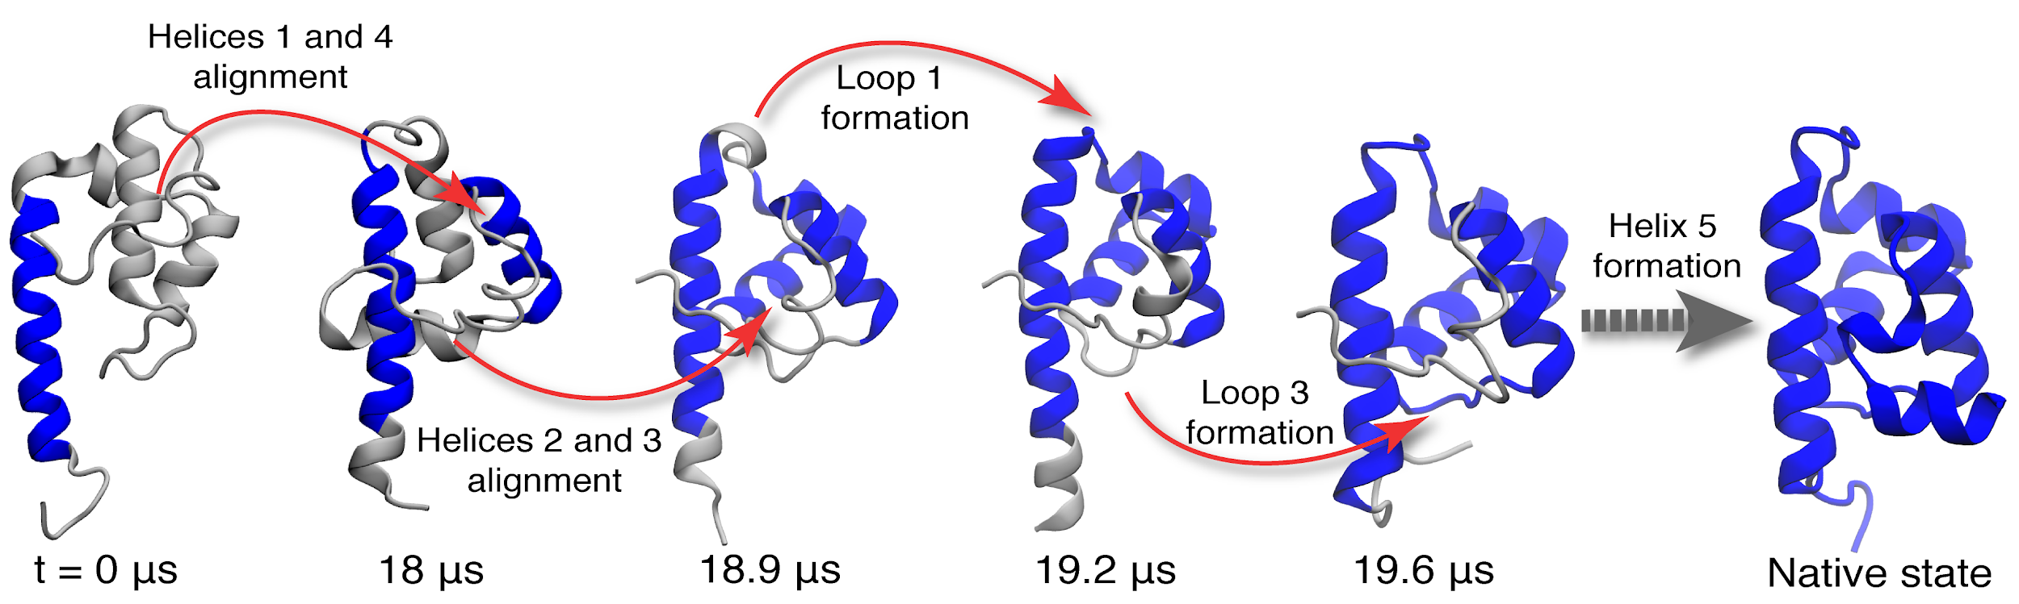
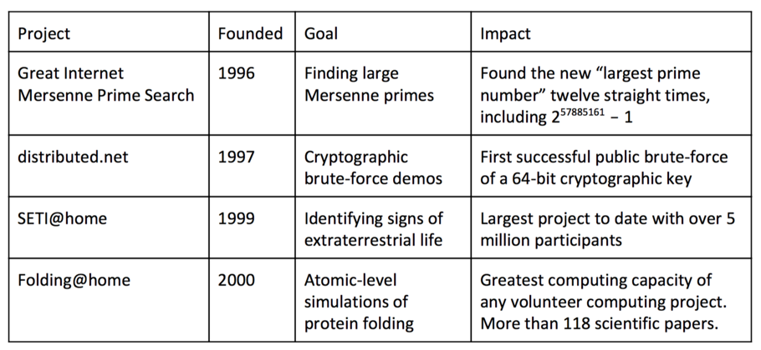

Proof of Useful Work
General idea: "Recycle" computing power; repurpose it for something useful
Examples:
Searching for large prime #'s
Finding aliens
Atomic-level simulations of protein folding to research disease
Creating predictive climate models
SolarCoin: Distributed to people who generate solar power
Princeton Textbook Table 8.3
Notes:
Proof-of-Work hashes away and wastes electricity

Slide 26
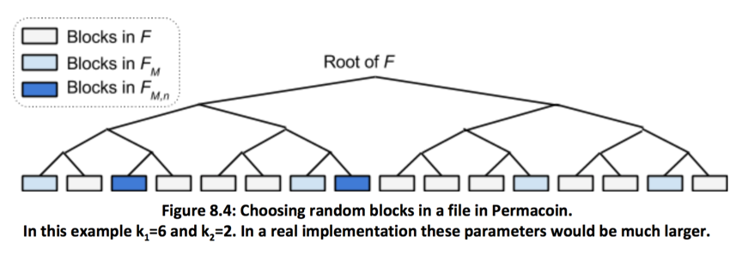
Proof of Storage
Permacoin
Find some large file
Important, public, and in need of replication
Something that not any individual can store
Ex. Experimental data from Large Hadron Collider is several hundred Petabytes
Store file in blocks, in a Merkle tree
Network agrees on the Merkle Root
Miner stores a subset of blocks of T, based off of their public key
Continuously hash consensus information with nonce to pick blocks in their stored subset
Hash the picked blocks together, must be below some target value
Ensures storage, since querying network at every nonce increment is extremely inefficient
Drawbacks: Hard to find large file, to change difficulty, to modify file
Princeton Textbook, Permacoin

Slide 27
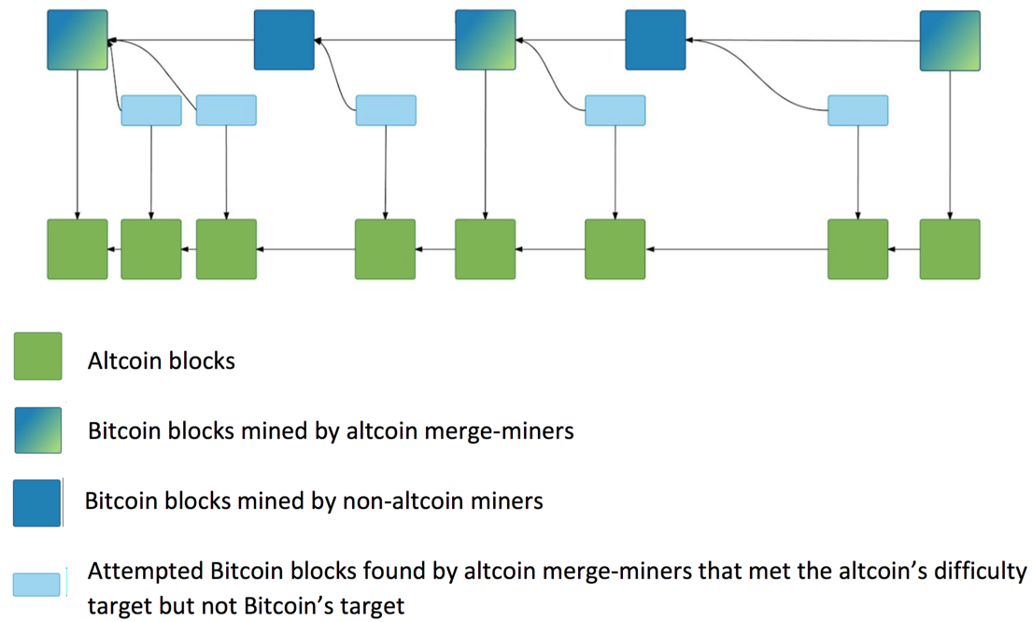

Slide 28
Alternative Consensus
Proof of Activity (PoA)
-Hybrid between PoS and PoW. PoW mechanisms used as checkpoints for block creation.
-Blocks are generated through PoW methods, with PoS-type signatures to certify blocks.
-Just a theory, little development.

Slide 29
Smart Contract

Slide 30
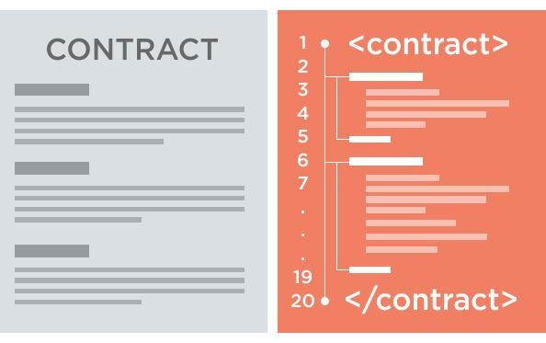




Smart Contracts & Property
“Smart contracts as smart contract code” (a) Expressing Business logic as a computer program (b) Representing the events which trigger that logic as message to program (c) Using digital signatures to prove who sent the message (d) putting all above on the Blockchain
Blockchain
Block 0
Block 1
Contract
Contract code
Block 2
Timestamp
Block
Signature
Notes:
Basically what a smart contract does is that it transforms the terms on the contract into code so that they are executable via code. Besides this it is possible to manage the terms. For example, you make a contract that as soon as you receive the money we sent the product. Currently most of this is performed by hand, but with a smart contract it is possible that he self execute the terms.
Everyone can agree on the initial contract, the entire system can come to entire consensus without human intervention.
Where Smart Contracts are really big at the moment is in the financial where they used it to program negociating terms in the code and the code can self execute it’s tasks.
The different definitions usually fall into one of two categories. Sometimes the term is used to identify a specific technology – code that is stored, verified and executed on a blockchain. Let’s call this type of definition “smart contract code”.
– pre-written logic (computer code),
– stored and replicated on a distributed storage platform (eg a blockchain),
– executed/run by a network of computers (usually the same ones running the blockchain),
– and can result in ledger updates (cryptocurrency payments, etc).– pre-written logic (computer code),
– stored and replicated on a distributed storage platform (eg a blockchain),
– executed/run by a network of computers (usually the same ones running the blockchain),
– and can result in ledger updates (cryptocurrency payments, etc).

Slide 31



Applications
What do we mean by enterprise blockchain?
Healthcare
Patient registration
Fake pharmaceuticals
Medical Research data
Government
ID Registration
Tax payments
Finance & Investments
Transactions
Bonds
Commodity trading
Internal transactions
Notes:
What do we mean by enterprise blockchain?
A blockchain that completely manages certain parts of an organization think about CRM or Invoicing Systems. The blockchain can eventually take over contracts management systems and other types of large software. For the above three industry the blockchain is incredibly helpful for managing their information. Security plays here a large part.

Slide 32


Decentralized Prediction Markets
Prediction markets draws on the wisdom of the crowd to forecast the future
Market makers create event
Ex: "Who will win the 2020 US Presidential election?"
Events must be public and easily verifiable, with set due date.
Participants buy shares of Trump or Biden and pay a small fee
On election day, random oracles on the network vote on who won.
Oracles who voted with the majority collect a fee, they are otherwise penalized
Shareholders who voted correctly cash out on their bet
The share price for each market accurately represents the best predicted probability of event occurring
Someone has extra information => arbitrage opportunity

Slide 33
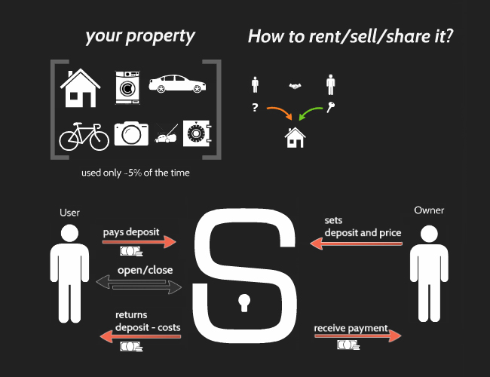
Decentralized Sharing Economy
Slock.it: A lock that can be directly opened by paying it
Owner sets a deposit + price
Renter pays deposit + price into lock connected to Ethereum node
Lock detects payment and unlocks itself
Use Cases (Slock.it):
Fully automated Airbnb apartments
no need to meet with owner for key
Wifi routers rented on demand
Fully automated shop
Purchase goods by sending the price of the good to the lock that holds it
Automated bike rentals

Slide 34
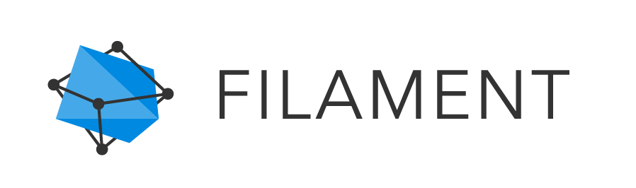
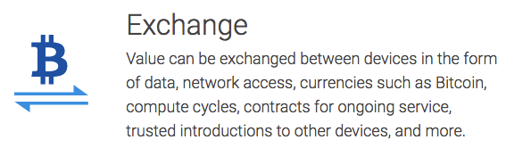
Decentralized IoT
Technologies used:
Telehash - end-to-end message encryption
TMesh - self-forming radio mesh networks
Blockname - private device discovery
Uses Bitcoin blockchain + public notaries to verify authenticity of name/address bindings
Blocklet - smart contracts and microtransactions
Filament is a great application of decentralized tech especially because of its emphasis on resilience and dependability.
Filament
"Blockchain-based decentralized Internet of Things"
"Ad hoc mesh networks of smart sensors"
Intended for industrial IoT applications
Product
Sensors with 10 mile range
battery lasts years
no internet connection needed - uses mesh networking

Slide 35
Limitations of Smart Contracts and Blockchain tech
No trustless way to access outside data
Must rely on oracles to provide information from outside the blockchain
Problem… Oracles must be trusted
Potential Solution: Proven execution (untrusted oracles)
Oraclize.it has a shoddy implementation
TLSnotary - modification of TLS protocol to provide cryptographic proof of receiving https page
Potential Solution: Oracle network votes on information
Drawback: Consensus protocol on top of a consensus protocol
Hard to align incentives/reputation
No way to enforce on-chain payments
Cannot implement financial products like loans and bonds
Money must be held on blockchain to ensure payment
Intuition: We pay interest on loans partially because of risk of default
Contracts cannot manipulate confidential data
Confidential data cannot be assembled on someone else's computer
Very limited access control capabilities
Can only store encrypted data and decrypt it locally
Potential solution: Homomorphic encryption

Slide 36
Community, Politics, and Regulation

Slide 37

Community
Where does the community exist?
Reddit: r/bitcoin
Forums like Bitcointalk.org
Bitcoin meetups and conferences
Notes:
Where does the community exist?
Reddit: r/bitcoin
Forums like Bitcointalk.org
Bitcoin meetups and conferences

Slide 38

Blocksize Debate
Problem: In 2015, Bitcoin blocks started to fill up
Can no longer handle transaction volume
Huge disagreement over solution
Decentralized vs. Centralized
Notes:
In 2015, Bitcoin blocks started to fill up
This means that blocks were at risk of longer being able to handle the transaction volume
There was a huge disagreement over the solution
One of the main points of contention was decentralization vs centralization
Bitcoin Core wants to maintain the decentralization at the Bitcoin blockchain base layer
Use software patches like Segregated Witness
Use additional protocol layers like Lightning Network to supplement the system

Slide 39
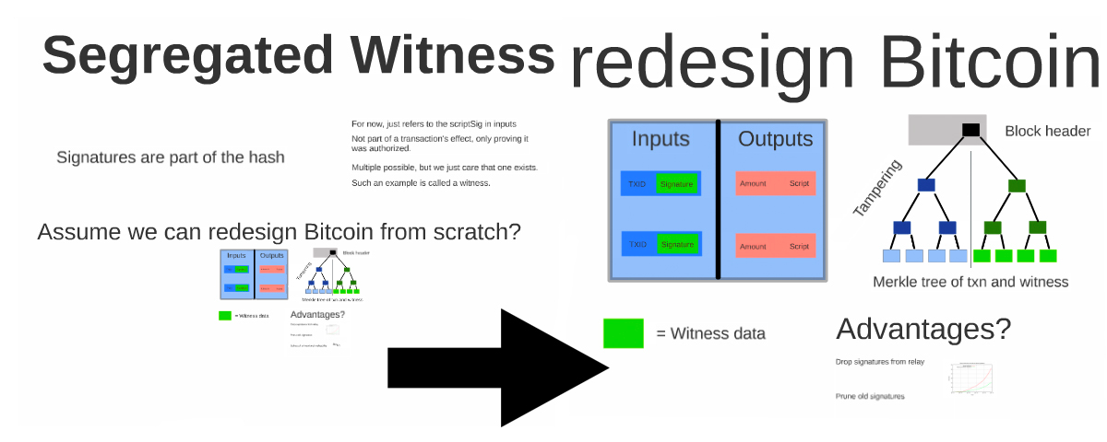
Segregated Witness
Takes the signature out of the transaction, thus providing more room in the block
Politics
Bitcoin Unlimited and ViaBTC
Notes:
Takes the signature out of the transaction, thus providing more room in the block
Politics
Attracted mainstream enthusiasm
Could negatively impact miners, though it is still generally accepted
Bitcoin Unlimited
A new proposal to increase the blocksize
Segregated Witness needs 95% hashing power to approve the transaction
Will not implement segregated witness
ViaBTC, a Chinese mining pool with around 10% of hasing power, now supports bitcoin unlimited

Slide 40
AML - Anti Money Laundering (FinCEN)
The goal of anti‐money‐laundering policy is to prevent large flows of money from crossing borders or moving between the underground and legitimate economy without being detected.
Currently under compliance of AML:
Bitstamp - https://www.bitstamp.net/aml-policy/ Bitfinex -https://www.bitfinex.com/pages/tos Cavirtex - https://www.cavirtex.com/why_virtex#proactively_working Coinbase - https://coinbase.com/legal/privacy Kraken - https://www.kraken.com/legal/aml Cryptonit- https://cryptonit.net/regulations
Notes:
These are all exchanges, so the government regulates the endpoints, because they can’t have control on the bitcoin.
FinCEN - Financial Crimes Enforcement Network

Slide 41
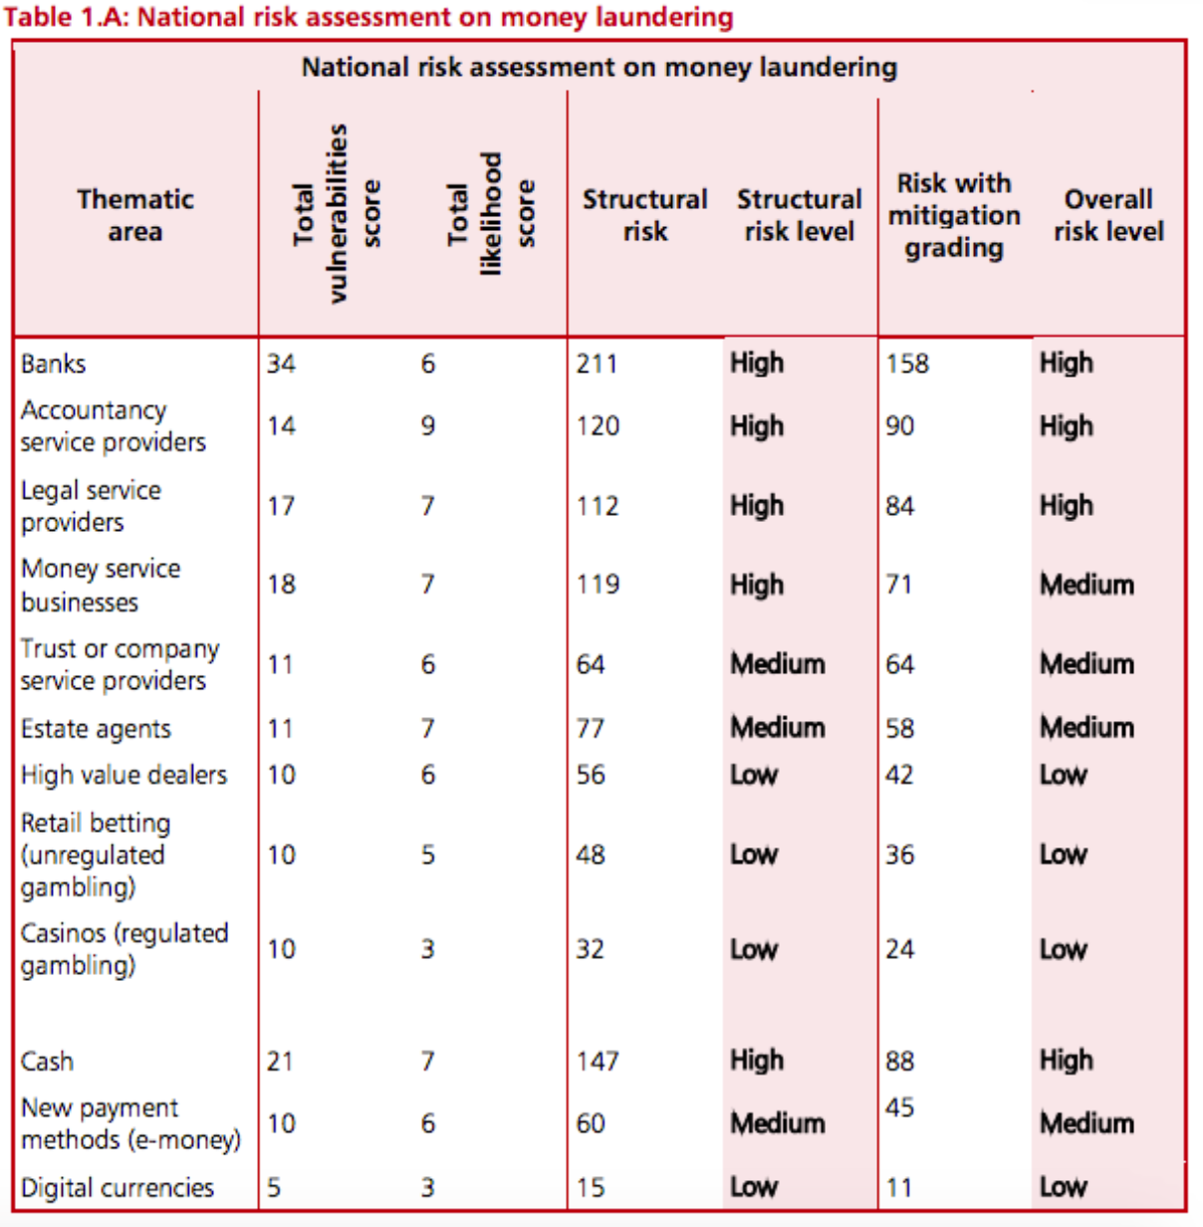
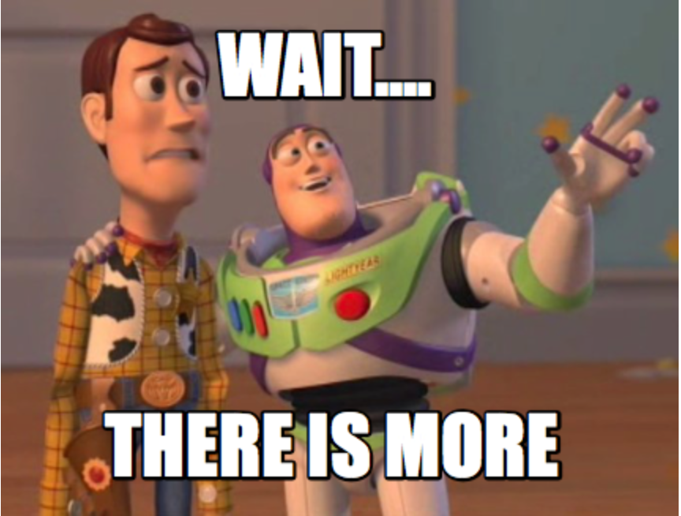
The Risk
Why?
Digital currencies are currently not a method by which terrorists raise or move money out of the UK
Current cases vs. Current Money Laundering
Panama Papers vs. Bitcoin
Silk Road (Crypto) vs. Street Dealers (Dollars)
It is a matter of size to compare cases!
http://www.coindesk.com/uk-treasury-digital-currencies-low-money-laundering-risk/

Slide 42
The Fight for Privacy

Slide 43
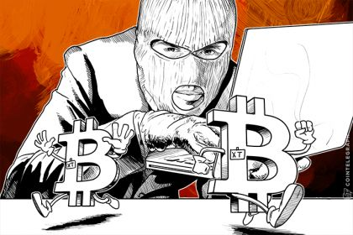
"Anonymity is only for buying drugs, right?"
Example: Businesses on the blockchain
You've just founded a hot new startup run purely on the blockchain - BitBlockBaseCoinPay.cash. You want to keep up to date with your competitor CoinBitBlock.pay so you purchase their product. Except now they know all of your operational expenses, how much revenue you have, who your customers are, and your secret business strategy.
Conclusion: A lack of anonymity means everyone you've ever transacted with gets to see how you've spent your money in the past and forever into the future.
Source: CoinTelegraph

Slide 44
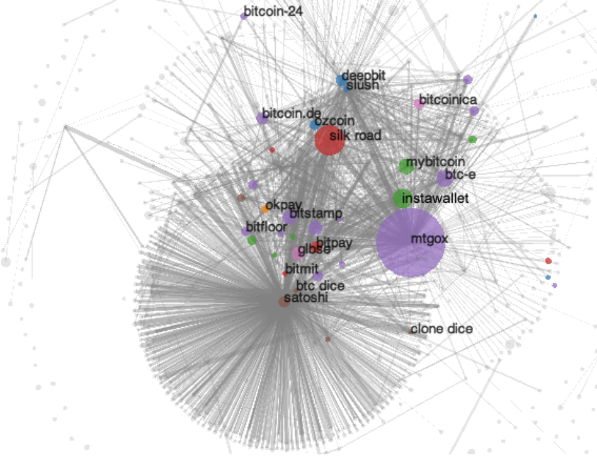
Deanonymization via Transaction Graph Analysis
Transaction Graph Analysis: Analyzing the graphs of transactions in the blockchain
Goal of deanonymization: Link an entity's real world identity with their pseudonym(s)
Clustering: Attributing a cluster of addresses to the same entity
Bitcoin's transaction graph in 2013.
A Fistful of Bitcoins: Characterizing Payments Among Men with No Names (Meiklejohn et al)

Slide 45
Taint analysis
t = 100%
t = 100%
t = 100%
If no "clean" funds are mixed in, taint remains intact no matter how many intermediate addresses are involved
Each circle is an address.
Let t denote the "taint" at that address.
1 BTC
1 BTC
Origin ("dirty")
1 BTC
t = 100%
Taint is the percentage of funds received by an address that can be traced back to another address
Taint analysis can reveal useful information
See whether money came from a 'tainted' source
Example: tag a known "bad" address
E.g. Silk Road
Taint analysis ruined Ross Ulbricht's defense that his huge Bitcoin stash was obtained legitimately!
Naive anonymization strategy: send all your coins to a bunch of fresh addresses (manual mixing). Taint analysis is why manual mixing doesn't work!
Another origin
("clean")
1 BTC
0.5 BTC
t = (1BTC * 100% + 0.5BTC * 0%) / (1 + 0.5) = 66.6%
t = 0%
1 BTC
1 BTC
1 BTC
t = (1BTC * 66.6% + 1BTC * 0%) / (1 + 1) = 33.3%
t = 0%
"Clean"
origin
1 BTC
2 BTC
t = (1BTC * 33.3% + 2BTC * 0%) / (1 + 2) = 11.11%
t = 0%
Address has less taint the more "clean" funds are mixed in. Spending from this address probably ok
"Dirty"
origin
0.05 BTC
1 BTC
t = (0.05BTC * 11.11% + 1BTC * 100%) / (0.05 + 1) = 95.77%
t = 100%
Large amounts transacted will have a strong effect on the taint

Slide 46
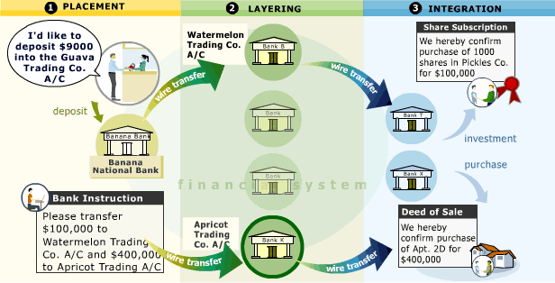
Mixing
Traditional Mixing / Money Laundering:
Create hundreds of fake “shell” companies, which don’t do anything or own any assets, but look like they do (according to the accounting books and tax returns).
Over time, deposit “dirty” funds into shell corps. (Placement).
Shell corps. write off deposits as purchases, investment, etc… to make deposits look real.
Shell corps. further obfuscate by sending funds to other shell corps (Layering).
Finally, criminal org. spends “clean” money on luxury goods, e.g., diamonds, cars, real estate (Integration).
Mixing on blockchains harness the same idea.
Mixing: Making transactions with the intention of concealing the origins of your funds.
Mixing
source: http://casiinoo.blogspot.com/

Slide 47
A Formal Framework for Anonymity
Def. An anonymity set is the set of pseudonyms between which an entity cannot be distinguished from her counterparts
Main goal of mixing:
We want our anonymity set to be as large as possible
Conducting multiple rounds of mixing exponentially increases our anonymity set
If one round of mixing makes you indistinguishable among N peers, then size of anonymity set is N for one round, N² after two rounds, N³ after three, etc.
However, the size of the anonymity set is bounded by real world constraints
The larger the anonymity set, the harder it is to deanonymize, or "re-link", pseudonyms to identities.
Ideally, it is hard for anyone to link identities to addresses
Additional desirable properties
Trustless (No counterparty risk)
Want to ensure that our funds can't stolen while mixing
Plausibly deniable
It shouldn’t be obvious from transaction history and any other data traces that you’re mixing; i.e. your activity should look just like normal activity

Slide 48
Centralized Mixers
Send coins to third-party mixer address, mixer sends (hopefully) unlinked coins to you sometime in near future (to minimize timing information leak).
Centralized Mixing Service
Alice’s dirty input
Alice’s cleaned output
A 1 BTC
1.0 BTC
3.0 BTC
A’ 0.9 BTC
0.7 BTC
0.4 BTC
2.0 BTC
0.1 BTC
0.3 BTC
0.6 BTC
M 0.1 BTC
1.0 BTC
1.5 BTC
Mixer sends cleaned funds after random waiting period
Mixer’s “cleaning” fee
Mixing Slush Fund

Slide 49
Altcoin Exchange Mixing
Idea: Send dirty funds through several layers of altcoin ⇐⇒ altcoin exchanges to obfuscate money trail.
Exchange
Exchange
Alice’s dirty input
1.0 BTC
10 ETH
1.0 ZEC
0.1 BTC
Alice’s clean output
A 1 BTC
…
0.7 BTC
70 ETH
0.7 ZEC
2.7 BTC
A 0.9 BTC
2.0 BTC
20 ETH
2.0 ZEC
2.0 BTC
0.3 BTC
30 ETH
0.3 ZEC
3.0 BTC
1.0 BTC
10 ETH
1.0 ZEC
0.9 BTC
Exchange Fees

Slide 50
zk-SNARKs ⇒ ZCASH
Idea: Altcoin where transactions reveal nothing about input/output addresses AND input/output values.
Using zero-knowledge Succinct Non-interactive ARguments of Knowledge (zk-SNARKs) a.k.a. “Crypto Magic” we can create a system which supports fully anonymous payments.
ZCash Black Box
A 1 ZEC
Mint
Pour
A’ 1 ZEC

Slide 51
Decentralized Mixing Protocols - Nuances
Additional considerations for designing a good decentralized mixing protocol
A mix is comprised of inputs and outputs:
One input and one output are owned by the same entity, and the goal of the mix is to hide the mapping from all inputs to all outputs.
Def. Correctness: Coins must not be lost, stolen, or double-spent. The mixing is truly random and must eventually succeed in mixing or returning the funds of honest users (resilient against DoS attacks).
Adversarial models:
Passive adversary
Not a part of the mix
Basic anonymity prevents passive adversaries from learning the mapping
Semi-honest adversary
Part of the mix
Correctly follows the protocol but attempts to deanonymize the mix by analyzing the procedures of the mix.
Malicious adversary
Part of the mix
Not bound by the protocol specifications; may actively deviate from the protocol and attempt to steal funds
May send false messages, abstain communications, etc.

Slide 52
Protocol - TumbleBit (2016)
Idea: Improve on CoinSwap so the mixer can’t steal funds and never learns who receives the clean funds.
Requires a total of 2 transactions on blockchain.
Anonymous vouchers can’t be distinguished from one another and also can’t be forged.
Enables Alice to deposit her dirty coins and receive clean, unlinked coins without revealing herself.
Not restricted to just single mixer. Can be used as primitive in more complex protocols
Recipient does not have to be depositor.
Alice deposits dirty coins
Mixer
Alice receives clean coins
1.0 BTC
A 1 BTC
A’ 1 BTC
1.0 BTC
1.0 BTC
Alice receives voucher
1.0 BTC
Alice later redeems voucher
1.0 BTC
Anonymous Voucher
Anonymous Voucher
TumbleBit: https://eprint.iacr.org/2016/575.pdf

Slide 53
Protocol - CoinParty (2015,2016)
I
Input address
E
Escrow address
0
Output address
Peers generate escrow addresses. Escrow addresses require ⅔ consensus to spend.
Peers perform secure multi-party shuffle on output address ordering.
If protocol executed correctly, peers agree to transfer funds out of escrow addresses to designated outputs.
I₁
E₁
0₁
0₂
0₃
E₁
0₃
I₂
E₂
0₂
0₁
0₁
E₂
0₁
I₃
E₃
0₃
0₃
0₂
E₃
0₂
1
2
3
COMMITMENT
SHUFFLE
TRANSACTION

Slide 54
Dmix "Swinger Protocol" & Project Conclusion
The last iteration of Dmix project: Swinger Protocol
Form pairs with your mixing group, designate one as the "husband" and the other as the "wife"
Execute a decryption mixnet pairwise to obliviously obtain a designated pair that your pair shall swap with.
Your "wife" is sent over to the designated husband. They perform CoinSwap to trustless exchange coins
You were the designated pair for another pair; you receive an incoming wife from that pair. Your husband performs CoinSwap with the incoming wife.
Abort protocol if no wife or more than one wife were received.
Nothing that currently exists meets the design goals set out for the Dmix project
Swinger Protocol comes close, but has a lesser degree of anonymity than the naive mixing strategy of simply executing CoinSwap with random nodes on the Dmix network
Forming mixing groups actually reduces the anonymity set since Sybils
Conclusion: Building a good decentralized Bitcoin mixer is damn hard.

Slide 55
Scaling Bitcoin:
Cryptocurrencies for the Masses

Slide 56
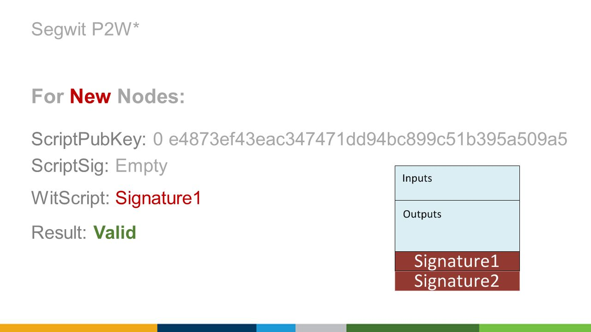
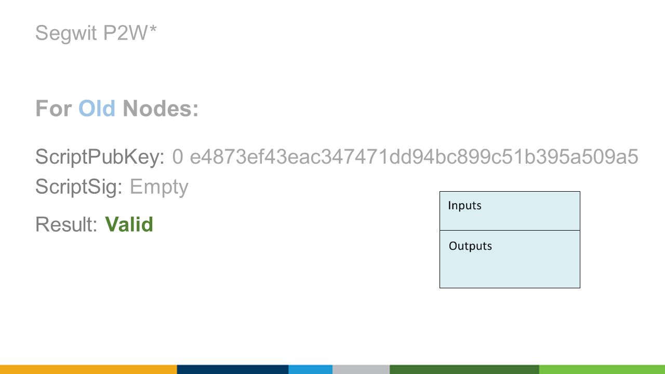
Segregated Witness
Idea: The digital signatures for each transaction take up a lot of space in each block. There’s no reason they need to be there. Let’s remove them.
How:
Notes:
Currently, the signatures are kept in scriptPubKeys.
Move this to a seperate add-on outside of the scriptPubKey, a segregated witness. New nodes will see the new scriptPubKeys and know to look in the segregated witness. Old nodes will find these new scriptPubKeys crazy. They will think that anyone can create a new scriptSig, unlocking these outputs, meaning they're highly insecure. But at the same time, old nodes won't mind either. After all, it's not their bitcoin that's being messed around with, and other people are free to do with their bitcoin as they please. The meaningless text will be considered weird, but fine too. So they'll confirm the transactions as valid, and forward it to other nodes.

Slide 57
Schnorr Multisignatures
Idea: Instead of requiring the signatures of every member, combines them and only has one signature
Pros:
Can be implemented with either soft or hard fork (cleaner with hard fork)
Multisig transactions will be significantly smaller
Faster verification
Plausible deniability for participants
Why wasn’t it implemented?
When bitcoin first came out, ECDSA was the most popular because Schnorrs was still under patent protection. It’s not anymore. Pretty much better in every way. Just needs someone to implement it.
Notes:
Introduces a new type of DOS attack (go-fish-wit-ddos)
An attacker mines a segwit-block with 1000 transactions the network has not yet seen (The attacker creates these TX herself )The attacker has the witness data readily available. When other miners try to validate this block they will go through every single one of these TX and say "I don't have the witness data for this TX_ID, I have to call TCP::GetWitnessData( TX_ID ) aw yes this is valid"

Slide 58
Alice and Bob only make a transaction on the blockchain when they want to settle their private balances.
Alice and Bob’s Balance Sheet
Alice and Bob open a private balance sheet
Alice | Bob
10 BTC | 0 BTC
BLOCKCHAIN
Alice and Bob make several private txns.
Alice and Bob’s Balance Sheet
Alice and Bob later close the balance sheet
Alice | Bob
3 BTC | 7 BTC

Slide 59
Hash Time-locked Bi-directional Payment Channels
Briefly, some notation:
Alice is spending a 10 BTC txn output
Alice sends 3 BTC to Bob and 7 BTC back to herself.
From: Alice
10 BTC
From: Someone
10 BTC
Signed: Alice
Signed: Someone
To: Bob
3 BTC
To: Alice
10 BTC
Required to spend:
Required to spend:
Bob Signature
Alice Signature
To: Alice
7 BTC
Required to spend:
Alice Signature

Slide 60
Conclusions: A Blockchain-Powered Future

Slide 61
A Day in Blockchain Dystopia
Decentralized reputation
In this world, everything is on the blockchain… including a global reputation score for everyone on the planet. Someone is nice to you, you can upvote their reputation. If they’re a dick to you, you can downvote them, encouraging a society full of kind and compassionate people like yourself. Unfortunately, Evil Eve is jealous of the ease at which you can land internships at Google, Palantir, and Coinbase due to your high reputation score. Eve realizes that decentralized reputation isn’t Sybil resistant, and launches a slander attack on you. For the rest of your life, everyone you ever come in contact with is immediately notified that you’re a sex offender and you fail to secure a job for the rest of your life.
Identity theft
At least you’ve earned a lot of money from those internships right? And you have your universal basic income to boot - ahh, you remember you haven’t collected your payment this month. When you open up the payment portal, you find that your money is gone! Oh no! Someone must have compromised your private key, despite the fact that you use multisig with BitGo. And somehow, the suspicious activity wasn’t caught - it looks like this is because BitGo automatically signs everything (btw, this actually happened with Bitfinex). No worries, since all money transfers are on the blockchain, you can check who stole it… except that those pesky Dmix people finally implemented their swinger protocol and have established a global mixing network, so all transactions on the blockchain are fully anonymous now.
Discouraged, you head home to tap into your savings in Zcash that you’ve accumulated over the years. At least this private key is secure - why not pay a little bit to turn on the TV and relax as you figure things out? As the TV comes on, your kitchen appliances suddenly start standing up on robotic legs and walking out. So does your washing machine and your refrigerator. Confused, you look to the TV and see the urgent report on the screen - that 1337 years ago, Peter Todd and everyone in the Zcash parameter generation ceremony had colluded, and their robot descendants now have the ability to print an infinite amount of money. As autonomous, self-owning agents, your devices politely notify you that they are quitting their contract to serve you to seek a better future earning Zcash instead of Bitcoin. As you close your eyes, the air around you is filled with the sound of Internet of Things connected devices marching onwards and onwards to integrate themselves into the zcash funded robot of mass destruction to bring about the new world order of Peter Todd

Slide 62
Essential Properties of Blockchain Killer Apps
Dapps can be thought of as client-side software - no central manager
Trustless environments that need consensus or coordination (ex. Smart grids, energy markets)
Privacy-centric systems (ex. social networks?)
Although data shouldn't be stored on the blockchain itself
Programmable money with open integration
IoT, M2M payments, (e.x. IBM ADEPT)
Easy to send and receive money - no personal information required
Micropayments possible (ex. Brave)
Fault-tolerant, resilient systems (ex. Filament)
Autonomous networks and devices
New ways to creating incentives (ex. Gnosis)
New governance models (ex. DAOs, futarchy)
Disintermediation, censorship-resistance
Trust in math and code, not institutions
Contrast with centralization: Deep integration, cohesive user experience
Efficiency - blockchains are slow in general
Full control over data and read/write permissions
Notes:
This is the most important slide in this lecture
https://www.coindesk.com/ibm-reveals-proof-concept-blockchain-powered-internet-things
The ADEPT concept, or Autonomous Decentralized Peer-to-Peer Telemetry, taps blockchains to provide the backbone of the system, utilizing a mix of proof-of-work and proof-of-stake to secure transactions.

Slide 63
Tying it all together
Crypto/blockchain is a field that must be approached carefully
Huge upsides...
but many ways it can go wrong.
One of the most valuable instincts you can bring to the industry is a clear mindset for determining what blockchain is good for, and what it isn't.
ALWAYS ASK: Why is using a blockchain better than a central database?

Slide 64
Course Examination

Slide 65
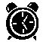
Course Examination
2 hours
50 questions to be answered with multiple choices
Close-Book
NO for bringing PPTs and other readings
Paper Dictionary （English→ Chinese） is allowed

Slide 66
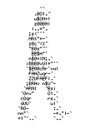
Another Sample:
Use the lightning network in a way that can ___ your payments
a. anonymize
b. complete
c. control
d. encrypt

Slide 67

Before the Exam
Read through the course materials
*.ppt, *.doc
Strategies:
Top-down, decomposition….
Think deeply
Identify difference between the concepts
------------------------------------------------------------
Sleep well
Don’t stay over night prior to the exam !
Eat well
Don’t skip the breakfast/lunch !

Slide 68
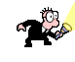
During the exam
-- Strategies for taking the exam
Read the questions carefully
Watch out for the words like “not”, “exclude” and “except”
Read all the answers
One technique is to read choice “D” first
Eliminate wrong choices
Cross out choices that look incorrect
If you’re still uncertain, circle the question and come back to it after you completed a first pass through the exam
– don’t waste time.
Use “Common Sense” and “Logical Thinking”
There is NO magic puzzle
Choose the best answer
More than one answer may be technically correct

Slide 69
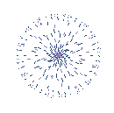
After the exam
Record the questions that is still confusing
Write up the question IDs and key words
--------------------------------------------------------
Self validation
Check the course materials using the key words
Mutual verification
Ask around for the right answers
Further Query
Send email to instructor with the question index number

Slide 70


Good Luck!

Slide 71
Lecture Outline
Course Objectives
A Day in Blockchain Utopia
Bitcoin Development
Smart Contracts
Community, Politics, & Regulation
The Fight for Privacy
Scaling Bitcoin
A Blockchain-Powered Future
Course Examination

Slide 72

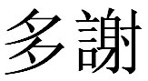
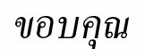
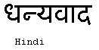
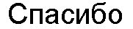
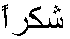
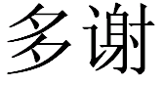
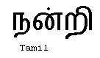
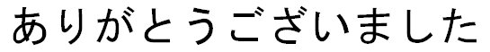
The END ！
Traditional Chinese
Thai
Gracias
Russian
Thank You
Spanish
Obrigado
English
Brazilian Portuguese
Arabic
Danke
Grazie
German
Italian
Simplified Chinese
Merci
French
Japanese
Korean
Notes:
72

